Slide 1
HackSprint 2021
Problem Statement : An Android application that scans the receipt using a mobile phone camera and stores the relevant data in a Pdf/ Excel form. The application upon installing should flash the company logo. Users will have an upload/scan button on the main screen. On clicking the button the application will access the mobile phone camera through which the receipt will be scanned and relevant data will be stored in the phone memory.
Problem Statement No. : PS09
Team Name : HS204_PS09
Team Number : 17
College Name : Pune Institute of Computer Technology, Pune.

Slide 2
Idea and Approach
We have decided to implement the problem statement using Flutter UI framework and for storage / authentication Firebase Service.
Initially we have created the authentication setup using only Google SignIn.
To recognize the text we have used FirebaseML Vision package.
To present the text recognized and extracted into pdf format we have used Flutter PDF package.
To view the previous scans we have uploaded them to the Firebase storage and then retrieved them in dashboard screen and viewed them through PDFTron Viewer.

Slide 3
Applications
In daily life we come across few instances where we want to edit text in image and convert it into required format and share the same .
For that purpose we first have to recognize the text and extract the text from the image and this where the app comes into picture .
The scope can also be extended where we want to translate the text on banners , posters from the foreign language to our native language .

Slide 4
Day 1
Initialized the github repo and uploaded empty project template.
Configured the Firebase SDK to the project.
Added Google Authentication to the app.
Implemented text OCR for the image either selected from gallery or captured through app.
Solved the issues faced during the implementation of OCR under the guidance of Mentor Karan Kharode.

Slide 5
Day 2
Implemented the generation of PDF with the text recognized in the input image.
Worked on uploading the generated PDF to Firebase Storage.
Worked on the firestore database to retrieve the previous files in the dashboard.
Worked on the UI portion

Slide 6
Day 3

Slide 7
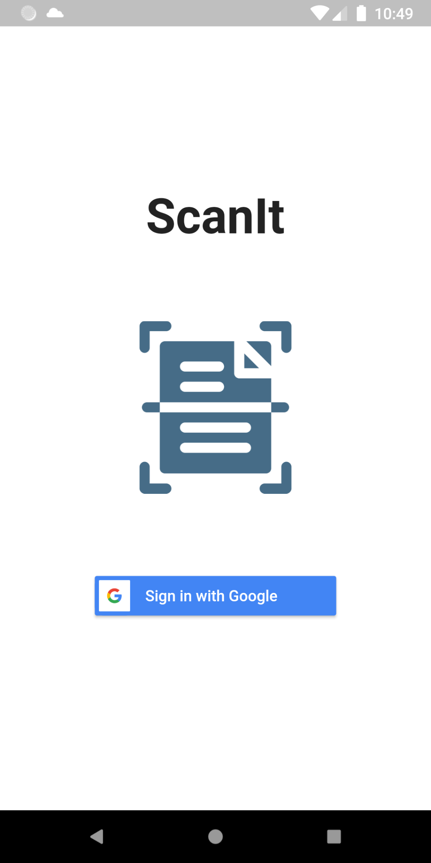
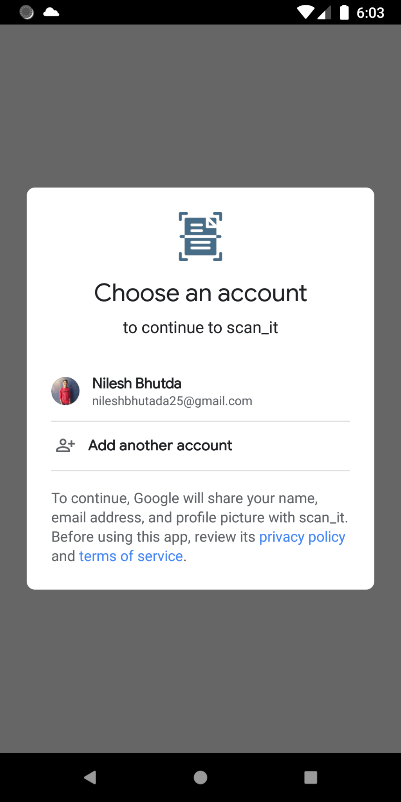
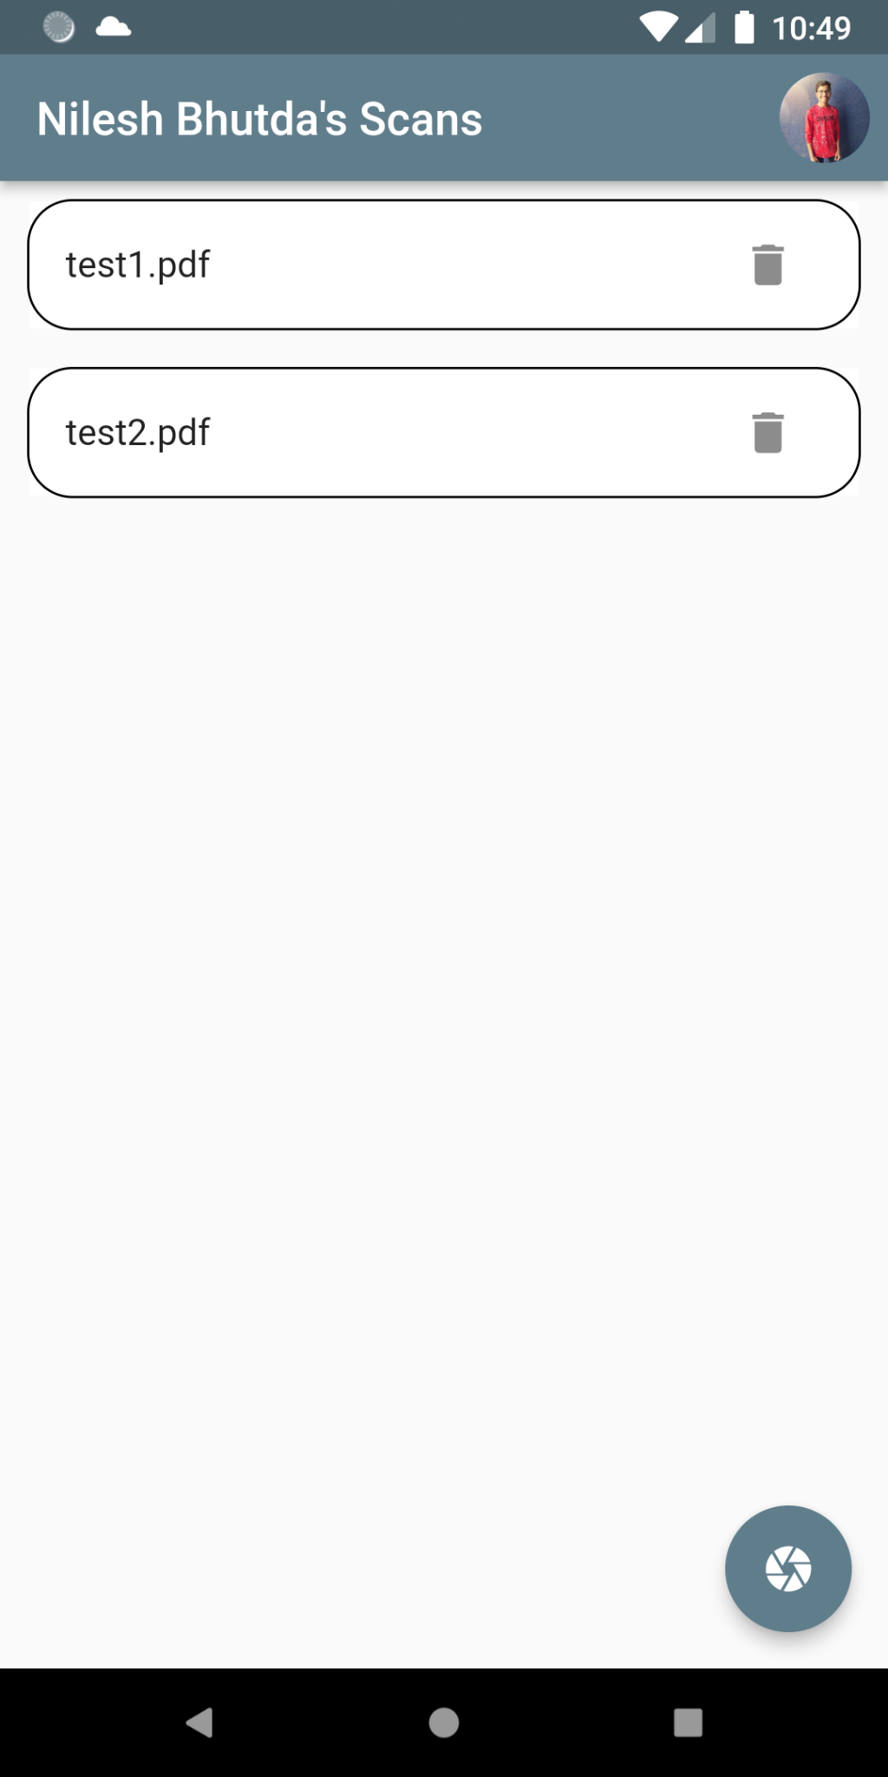

Slide 8
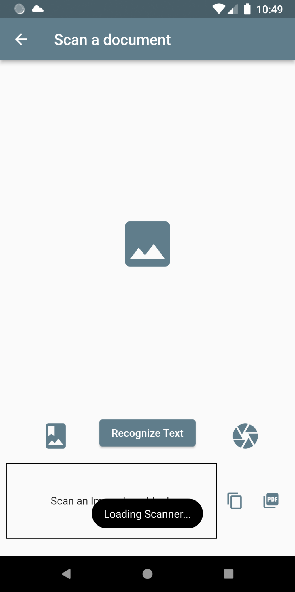
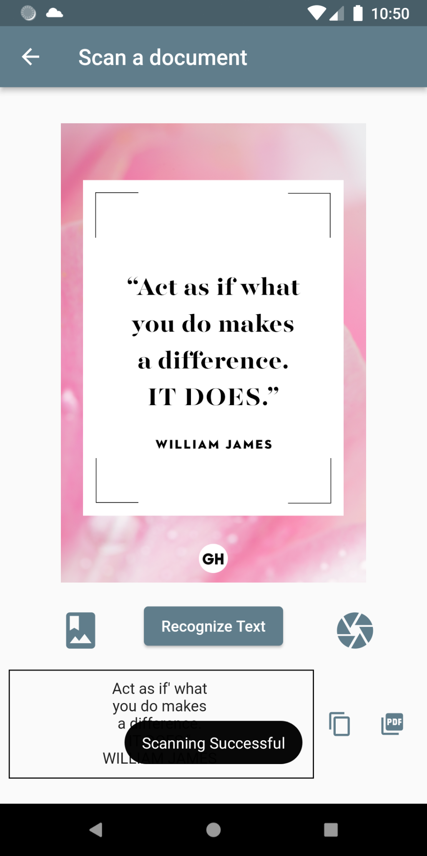
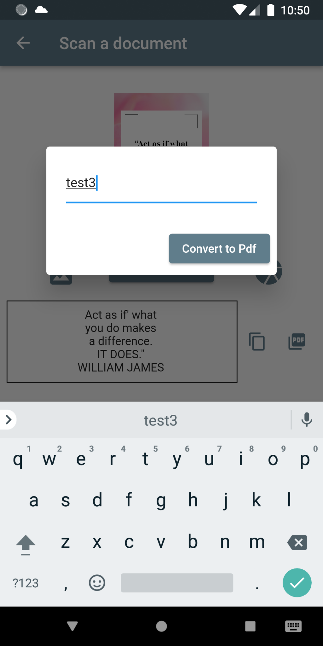

Slide 9
